Slide 1







Identifying trends and emerging skills for IT Consultants
Michael Gimlewicz
10/02/2023

Slide 2



OUTLINE
Executive Summary
Introduction
Methodology
Results
Visualization – Charts
Dashboard
Discussion
Findings & Implications
Conclusion
Appendix

Slide 3

EXECUTIVE SUMMARY
What are the top programming languages in demand?
What are the top database skills in demand?
What are the popular IDEs?
What trends can we identify from the data?
What skills and technologies will be important to know in the future?

Slide 4

INTRODUCTION
In a rapidly advancing technological landscape, IT consultants need to remain up to speed with evolving tools and technologies.
Stack Overflow conducted an online survey of online professionals around the world which was analyzed for implications about popular languages and databases.
The data set has around 90,000 responses.
The randomized subset used in this analysis contains around 1/10th of the original data set.

Slide 5

METHODOLOGY
Data is scraped from websites and collected from APIs to be analyzed.
The data is wrangled to be cleaned and prepared for analysis.
The data is statistically analyzed to examine trends and gain insights.
Visualizations are created to help illustrate the pertinent findings from the data analysis.

Slide 6

RESULTS
RESULTS

Slide 7
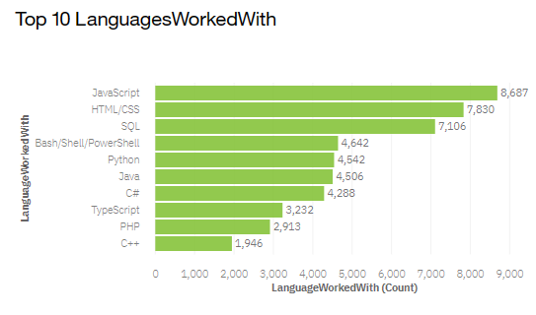
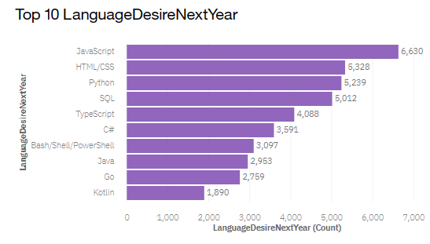
PROGRAMMING LANGUAGE TRENDS
Current Year
Next Year
<Bar chart of top 10 programming languages for the current year goes here.>
< Bar chart of top 10 programming languages for the next year goes here.>

Slide 8
PROGRAMMING LANGUAGE TRENDS - FINDINGS & IMPLICATIONS
Findings
JavaScript, HTML / CSS are the top 2 current and future projected desired programming languages
Python and TypeScript are projected to grow in the following year
Implications
Students and aspiring programmers should have a solid foundational knowledge of JavaScript and HTML / CSS
Growing languages provide alternative options for developers

Slide 9
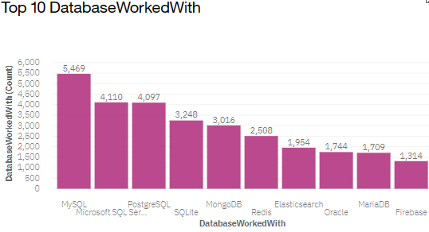
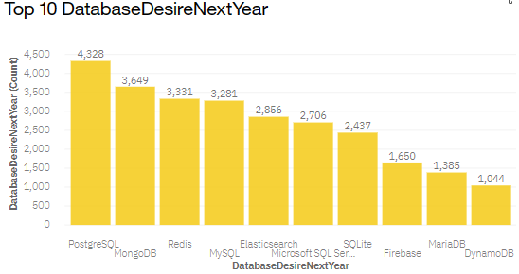
DATABASE TRENDS
Current Year
Next Year
< Bar chart of top 10 databases for the current year goes here >
< Bar chart of top 10 databases for the next year goes here.>

Slide 10
DATABASE TRENDS - FINDINGS & IMPLICATIONS
Findings
MySQL, Microsoft SQL Server, Postgre SQL and SQLite are the top 4 current databases worked with
Postgre SQL, MongoDB, Firebase and Redis are growing in popularity
Implications
The top 4 databases emphasize SQL proficiency

Slide 11

DASHBOARD
https://dataplatform.cloud.ibm.com/dashboards/38fec213-3eda-4d1b-8e2f-23fbb02ea154/view/0360e93504ac2ef269d0f6e407cb7d5579332659b7bb855783827b4906347297f03d16c0c87d4d08da160c63a0be460c9a

Slide 12
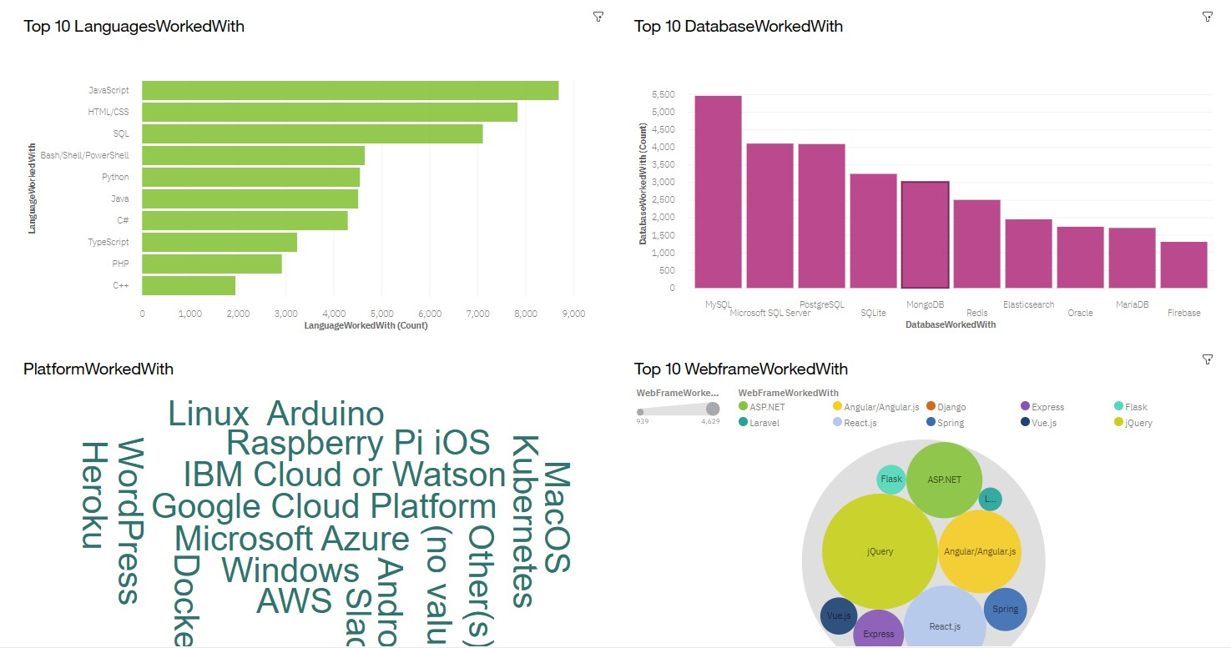
DASHBOARD TAB 1
Screenshot of dashboard tab 1 goes here

Slide 13
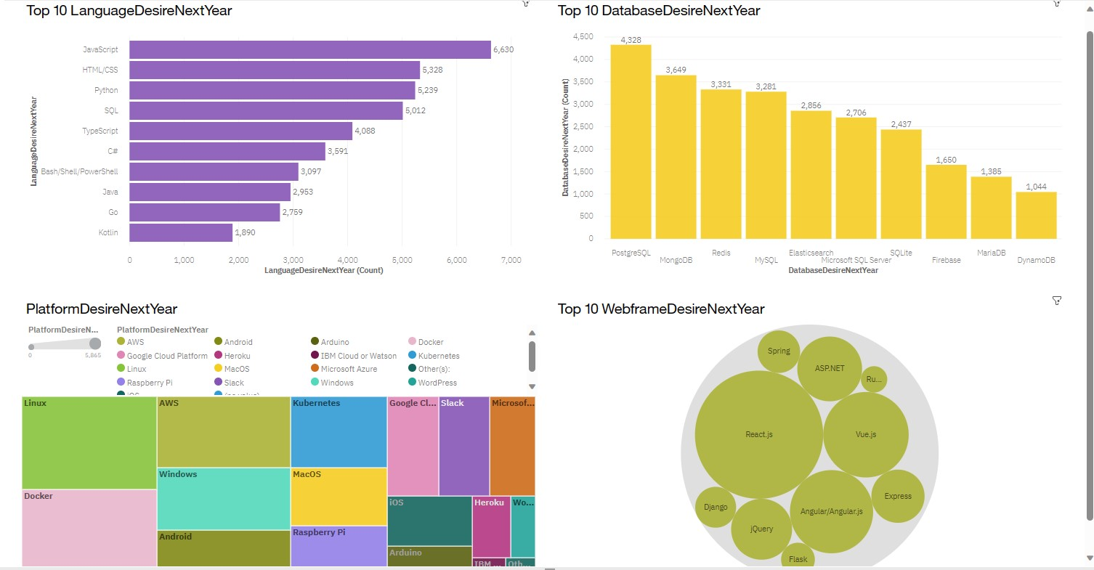
DASHBOARD TAB 2
Screenshot of dashboard tab 2 goes here

Slide 14
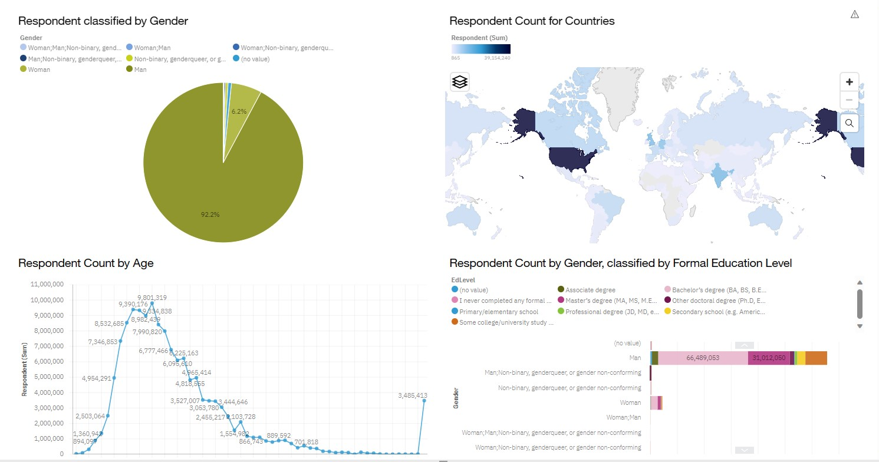
DASHBOARD TAB 3
Screenshot of dashboard tab 3 goes here

Slide 15

DISCUSSION

Slide 16
OVERALL FINDINGS & IMPLICATIONS
Findings
JavaScript, HTML / CSS, Python and SQL are the most prominent languages heading into next year
Most survey respondents reside in the US or India
Implications
Well known languages are projected to remain as most desired
Developers in the data are mostly concentrated rather than spread evenly

Slide 17

CONCLUSION
Software professionals are well served to be versed in multiple languages and databases.
There is room to grow the software industry in several underexplored markets.
Technology continues to evolve, and in demand skills are dependent on popular languages, databases and webframes.

Slide 18

APPENDIX
Job Dataset available under a Public Domain License:
https://www.kaggle.com/promptcloud/jobs-on-naukricom
Dashboard Dataset available under an Open Database License:
https://stackoverflow.blog/2019/04/09/the-2019-stack-overflow-developer-survey-results-are-in/

Slide 19
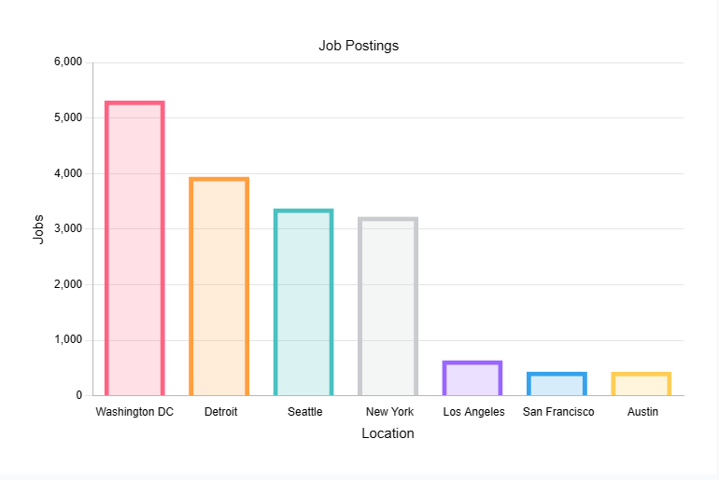
JOB POSTINGS
In Module 1 you have collected the job posting data using Job API in a file named “job-postings.xlsx”. Present that data using a bar chart here. Order the bar chart in the descending order of the number of job postings.

Slide 20
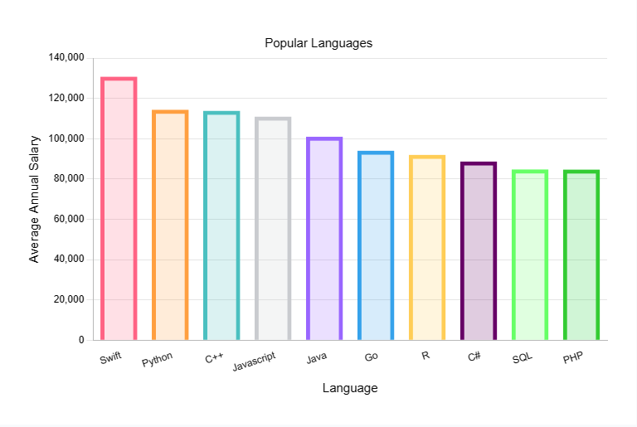
POPULAR LANGUAGES
In Module 1 you have collected the job postings data using web scraping in a file named “popular-languages.csv”. Present that data using a bar chart here. Order the bar chart in the descending order of salary.

